Slide 1
Course Name : Data Structures & Algorithms
Bharat Deshpande
Computer Science & Information Systems

Slide 2
Open Addressing
An alternative to chaining for handling collisions.
Idea:
Store all keys in the hash table itself.
Each slot contains either a key or NIL.
To search for key k:
Examine slot h(k). Examining a slot is known as a probe.
If slot h(k) contains key k, the search is successful. If the slot contains NIL, the search is unsuccessful.
There’s a third possibility: slot h(k) contains a key that is not k.
Compute the index of some other slot, based on k and which probe we are on.
Keep probing until we either find key k or we find a slot holding NIL.
Advantages: Avoids pointers; so can use a larger table.

Slide 3
Probe Sequence
Sequence of slots examined during a key search constitutes a probe sequence.
Probe sequence must be a permutation of the slot numbers.
We examine every slot in the table, if we have to.
We don’t examine any slot more than once.
The hash function is extended to:
h : U × {0, 1, …, m – 1} → {0, 1, …, m – 1}
probe number slot number
⟨h(k,0), h(k,1),…,h(k,m–1)⟩ should be a permutation of ⟨0, 1,…, m–1⟩.

Slide 4
Insert Operation
Act as though we were searching, and insert at the first NIL slot
found
Hash-Insert(T, k)
1. i ← 0
2. repeat j ← h(k, i)
3. if T[j] = NIL
4. then T[j] ← k
5. return j
6. else i ← i + 1
7. until i = m
8. error “hash table overflow”

Slide 5
Search Operation
The search algorithm for key k probes the same sequence of
slots that the insertion algorithm examined when k was inserted.
Hash-Search (T, k)
1. i ← 0
2. repeat j ← h(k, i)
3. if T[j] = k
4. then return j
5. i ← i + 1
6. until T[j] = NIL or i = m
7. return NIL

Slide 6
Deletion Operation
Cannot just turn the slot containing the key we want to delete to contain NIL.
Doing so might make it impossible to retrieve any key k during whose insertion we had probed this slot & found it occupied.
Use a special value DELETED instead of NIL when marking a slot as empty during deletion.
Search should treat DELETED as though the slot holds a key that does not match the one being searched for.
Insert should treat DELETED as though the slot were empty, so that it can be reused.
Disadvantage: Search time is no longer dependent on α.
Hence, chaining is more common when keys have to be deleted.

Slide 7
Probe Sequences
The ideal situation is uniform hashing:
Generalization of simple uniform hashing.
Each key is equally likely to have any of the m! permutations of ⟨0, 1,…, m–1⟩ as its probe sequence.
It is hard to implement true uniform hashing.
Approximate with techniques that at least guarantee that the probe sequence is a permutation of ⟨0, 1,…, m–1⟩.
Three commonly used techniques:
Linear Probing.
Quadratic Probing.
Double Hashing.
All guarantee that ⟨h(k,0), h(k,1),…,h(k,m–1)⟩ is a permutation of ⟨0, 1,…, m–1⟩.
None of these fulfills assumptions of uniform hashing.
Can’t produce all m! probe sequences.

Slide 8
Linear Probing
h(k, i) = (h′(k)+i) mod m.
The initial probe determines the entire probe sequence.
T[h′(k)], T[h′(k)+1], …, T[m–1], T[0], T[1], …, T[h′(k)–1]
Hence, only m distinct probe sequences are possible.
Easy to Implement
Suffers from primary clustering:
Long runs of occupied sequences build up.
Long runs tend to get longer, since an empty slot preceded by i full slots gets filled next with probability (i+1)/m.
Hence, average search and insertion times increase.
key
Auxiliary hash function
Probe number

Slide 9
Linear Probing : Example
Example:
h’(x) = x mod 13
h(x)=(h’(x)+i) mod 13
Insert keys 18, 41, 22, 44, 59, 32, 31, 73, in this order
0
1
2
3
4
5
6
7
8
9
10
11
12
41
18
44
59
32
22
31
73
0
1
2
3
4
5
6
7
8
9
10
11
12

Slide 10
Quadratic Probing
h(k, i) = (h′(k) + c₁i + c₂i²) mod m c₁≠ c₂
The initial probe position is T[h′(k)], later probe positions are offset by amounts that depend on a quadratic function of the probe number i.
Must constrain c₁, c₂, and m to ensure that we get a full permutation of ⟨0, 1,…, m–1⟩.
Can suffer from secondary clustering:
If two keys have the same initial probe position, then their probe sequences are the same.
key
Probe number
Auxiliary hash function

Slide 11
Double Hashing
h(k ,i) = (h₁(k) + i h₂(k)) mod m
Two auxiliary hash functions.
h₁ gives the initial probe. h₂ gives the remaining probes.
Must have h₂(k) relatively prime to m, so that the probe sequence is a full permutation of ⟨0, 1,…, m–1⟩.
Choose m to be a power of 2 and have h₂(k) always return an odd number. Or,
Let m be prime, and have 1 < h₂(k) < m.
Θ(m²) different probe sequences.
One for each possible combination of h₁(k) and h₂(k).
Close to the ideal uniform hashing.
Best method available for open addressing
key
Probe number
Auxiliary hash functions

Slide 12
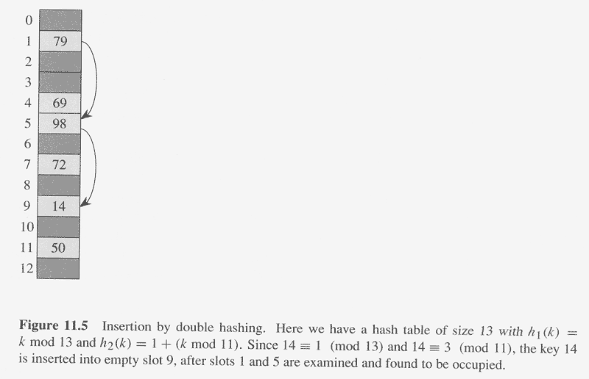
Copyright © The McGraw-Hill Companies, Inc. Permission required for reproduction or display.

Slide 13
Performance of Open Addressing
Theorem:
The expected number of probes in an unsuccessful
search in an open-address hash table is at most 1/(1–α).
Corollary:
Inserting an element into an open-address table
takes ≤ 1/(1–α) probes on average.
If α is a constant, search/insertion takes O(1) time.

